Slide 1





Testing The Web
… Quelle idée!
Raed Chammam
<raed.chammam@gmail.com>
19/10/2017

Slide 2
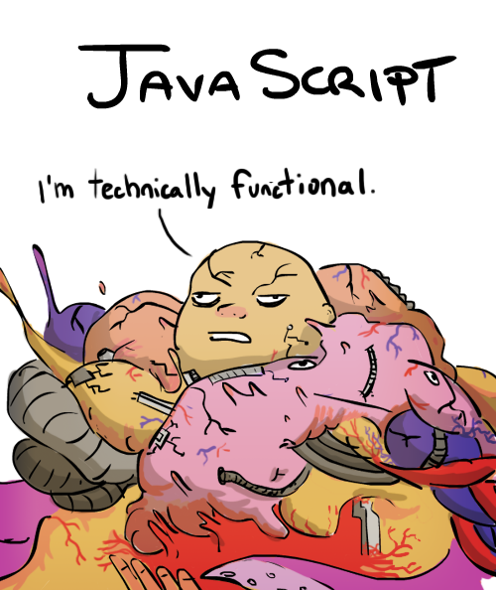

Automated Testing
Educational minimum
Functional !?
Notes:
Quand on code :
Imaginer ce qu’on peut faire en fonctions
Quel paramètres donne quels résultats
Code and run until it works … imperfect approch as we might miss edge cases..
Tests separate from the code

Slide 3
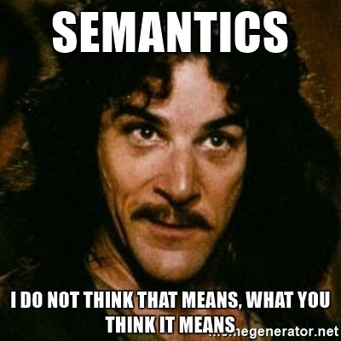
Semantics
Unit Testing
Integration testing
2E2, TDD, BDD, WTF!
“Unit of Code”→ function (simple, quick)
“TDD” → Write your test before your code (code-coverage)
“BDD”→ Test behavior not implementation (no implied values or behavior) “self contained”
Notes:
Behavior Driven Development : Tests AND documentation AND examples.

Slide 4


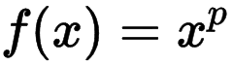
Show Me The Code!
Editor time !
Modern browser
Node.js > 6
function pow(x, p)

Slide 5
Remember… Remember…
describe('raises x to power n’ …
it(‘expected behavior’…
mocha.setup(‘bdd’)
expect(something).to. …
Documentation !!!
Notes:
Describe: functionality we’re describing
IT: human-readable way describe the particular use case

Slide 6
Thank you
Raed Chammam <raed.chammam@gmail.com>
raed.it | raed.tn
https://github.com/RaedsLab/TestingTheWeb/

